Slide 2
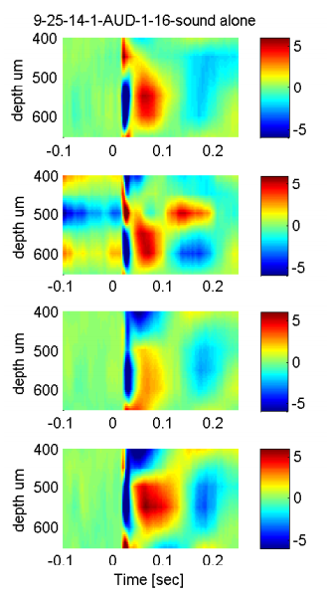
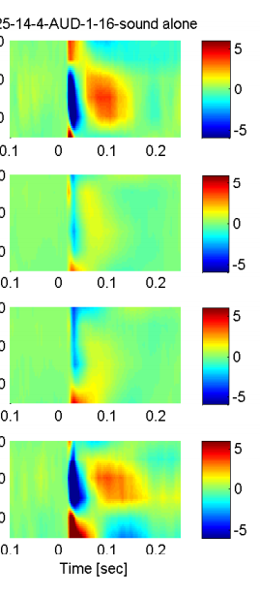
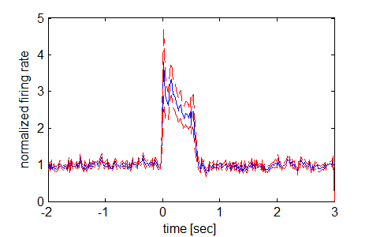
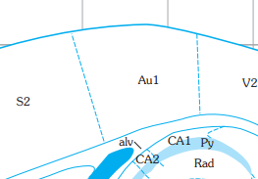
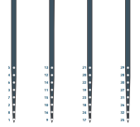
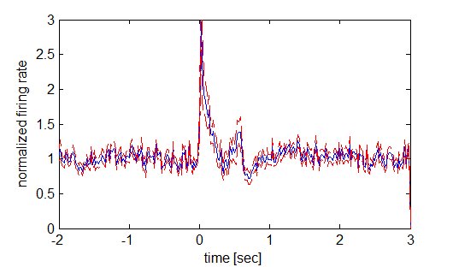
CSD and Spectral/pop_CSD_sound_only (snipped from pdf)
Figure 2: Scopolamine reduces noise-evoked intra-cortical current sources in auditory cortex. (left) Illustration of recording electrode/infusion pipette configuration and position within auditory cortex.

